Slide 1



Understanding peer review
Adrian Martín Bethencourt
MSc Social Data Analytics

Slide 2
Table of content
Peer review
SFI
Sentiment Analysis
My internship
ABM
The Chair
Conservativism

Slide 3
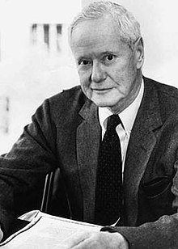


Science
Mertonian ethos of science
Science is not only a research method but an institution
Universalism
Communalism
Disinterestedness
Organized skepticism
Peer review
Robert K. Merton

Slide 4



Science Foundation Ireland
Stage 1
Stage 2
Final scores
Postal review
Panel discussion

Slide 5

Science Foundation Ireland
Sections
Applicant
Research programme
Potential for impact
Numerical scores
Comments on the sections

Slide 6
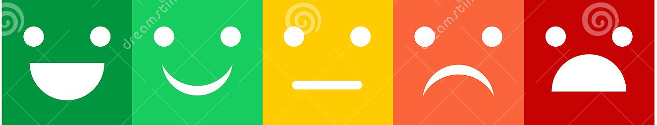
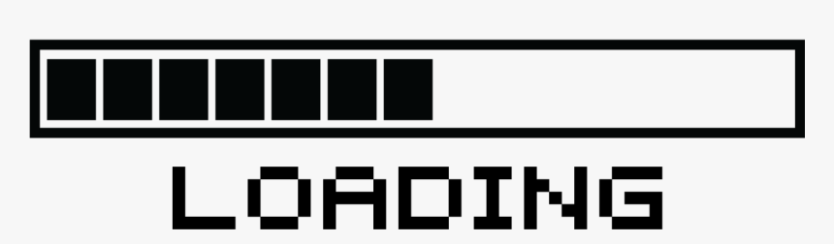
Sentiment Analysis (SA)
Comments on the Sections
Sentiment Analysis
Applicant
Research programme
Potential for impact
Very negative
Moderate negative
Moderate positive
Very positive
Neutral
(Luo et al. 2020:1)

Slide 7
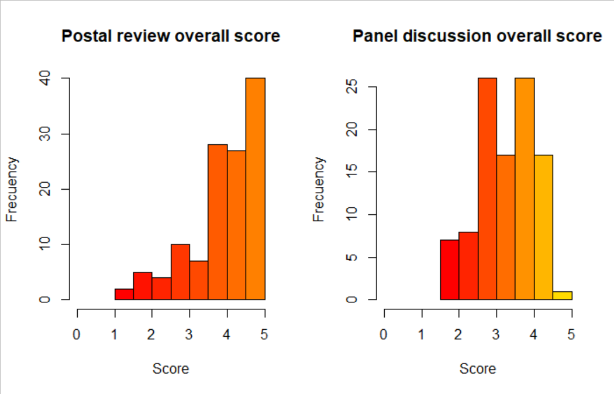
My internship
Stage 1. Overall score
Stage 2. Overall score
Reproducing the distribution of review scores with an ABM.
BLACK-BOX

Slide 8


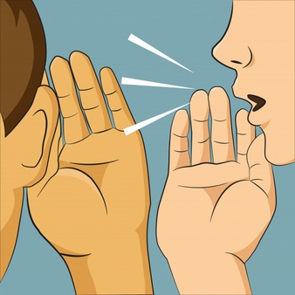
Agent Based Modelling (ABM)
(Feliciani et al. 2020:3; Flache et al. 2017:6).
Assimilative influence
Repulsive influence
Reinforcing influence
Minimize the individual disagreement towards others by been influenced by the group
Increase disagreement when opinions are too dissimilar
Amplify an initial opinion tendency by adopting progressively more extreme opinions
(Feliciani et al. 2020:3; Flache et al. 2017:6)

Slide 9
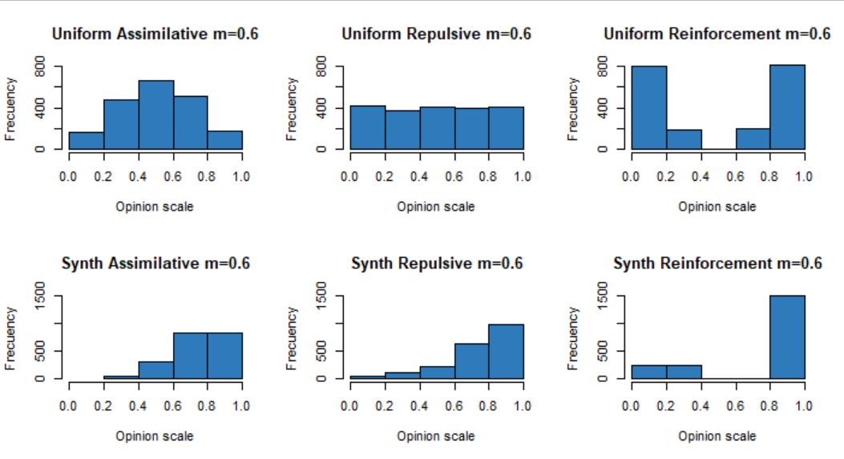


Testing social influence
Uniform distribution
Synthetic population
¿?

Slide 10

The role of the chair (m)
Panel discussion
Structured
Unstructured
m= 1
m
m= 0

Slide 11
The role of the chair (m)

Slide 12
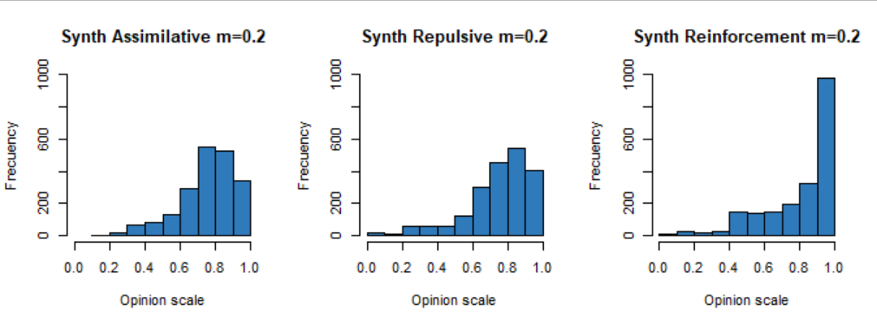
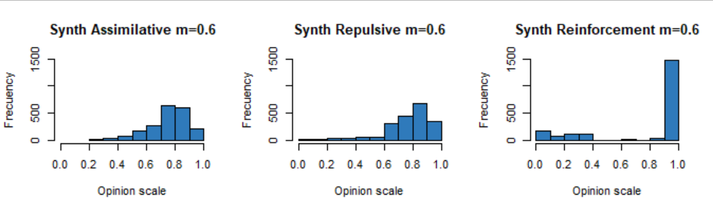
The role of the chair
Stage 1. Overall score
Stage 2. Overall score

Slide 13
The role of the chair
Stage 1. Overall score
Stage 2. Overall score

Slide 14
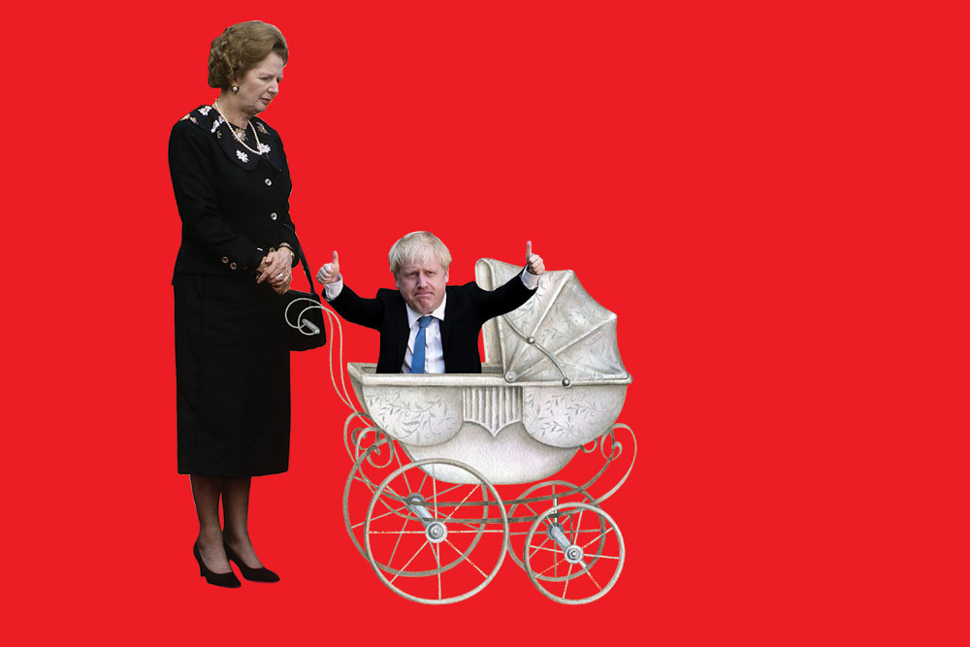

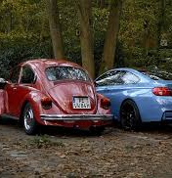
Conservstivism

Slide 15

The role of bias: Conservativism
Bias size: the size of the bias against novelty
Initial score + Bias size
Well balanced
P=(0.0911)*
+
Social influence
Novel proposal
P=(4/10)
Initial score – Bias size
Not well balanced
P=(0.40 - 0.0911)
+
Social influence
Initial score
Conventional proposal
+
Social influence
P=(6/10)
* See Brian Uzzi et al. (2013)

Slide 16

The role of bias: The gender mechanism
Bias size: the size of the bias against the applicant
Initial score + Bias size
Outstanding record
e.g. p=(0.0911)
+
Social influence
Female
e.g. p=(4/10)
Initial score – Bias size
Average record
e.g. p=(0.40 - 0.0911)
+
Social influence
Initial score
Male
+
Social influence
e.g. p=(6/10)

Slide 17

Conservativism mechanism
Number of reviewers
Influence
4
5
6
Balanced
Unbalanced
Positive bias: +x
Positive bias: +x +0.2
Negative bias: -x
Negative bias: -x

Slide 18
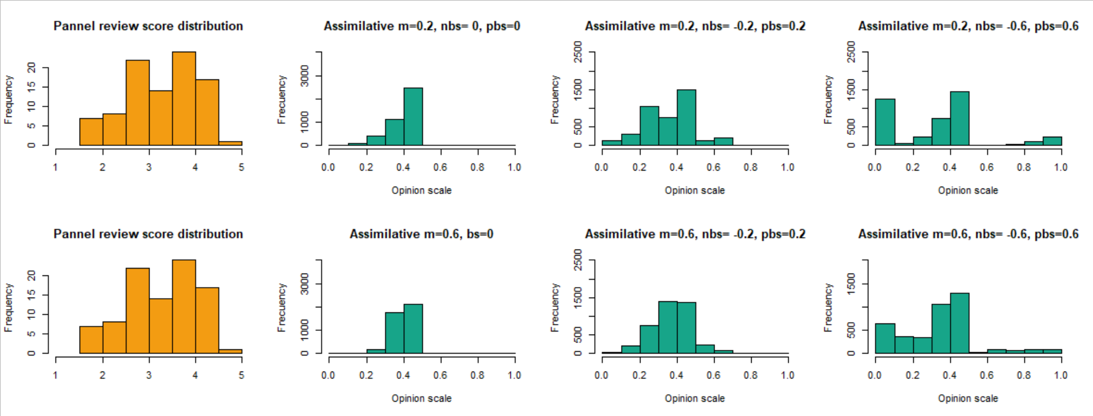
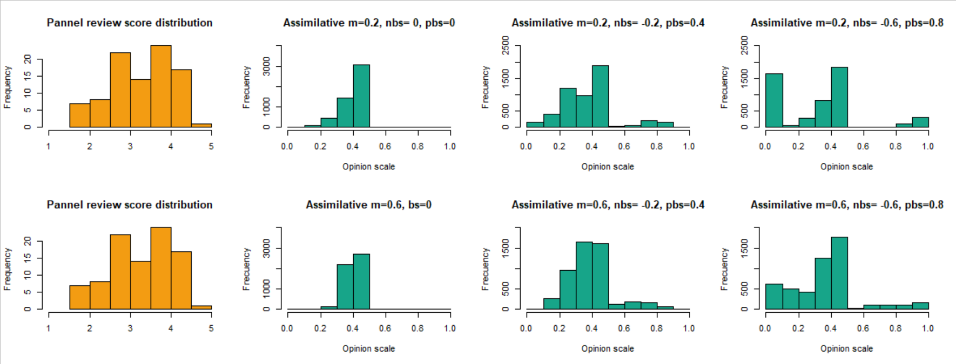
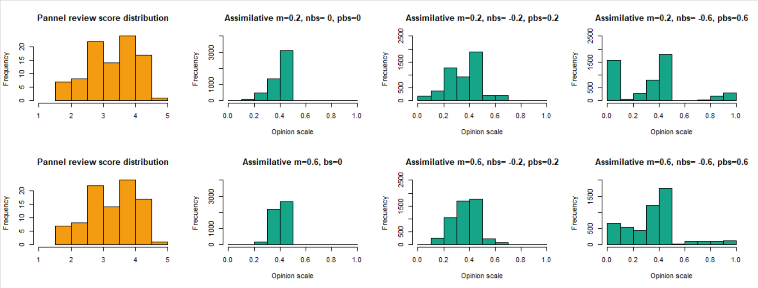
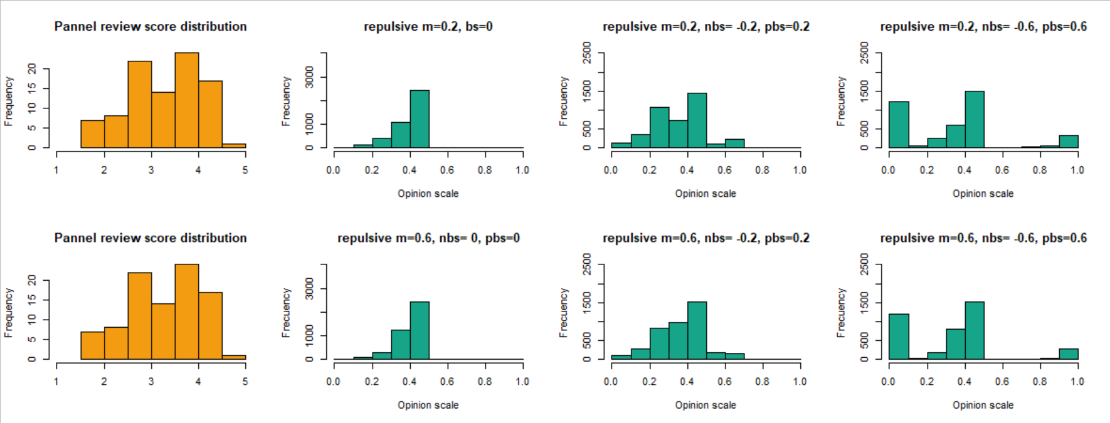
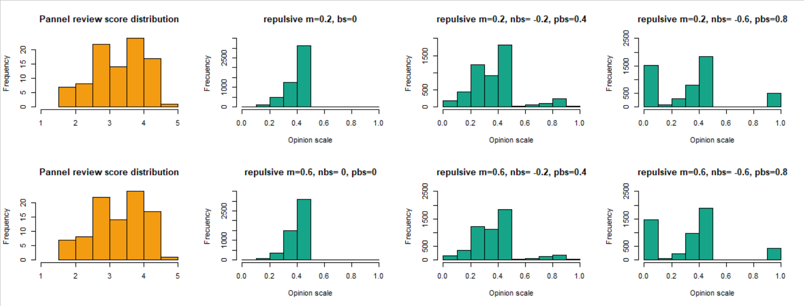
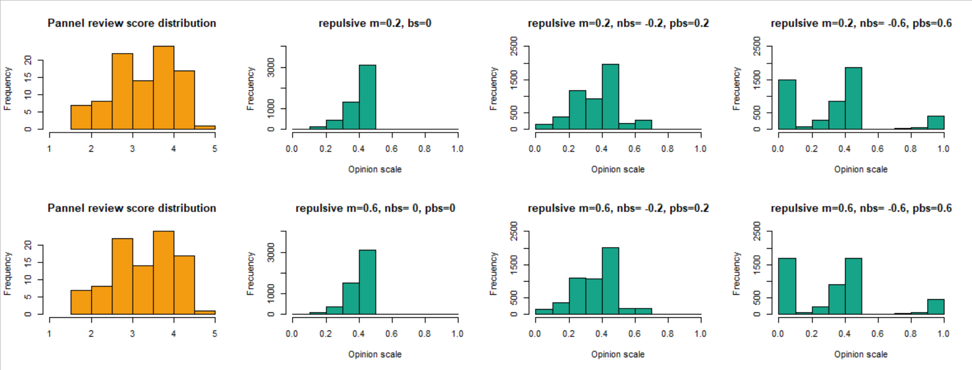
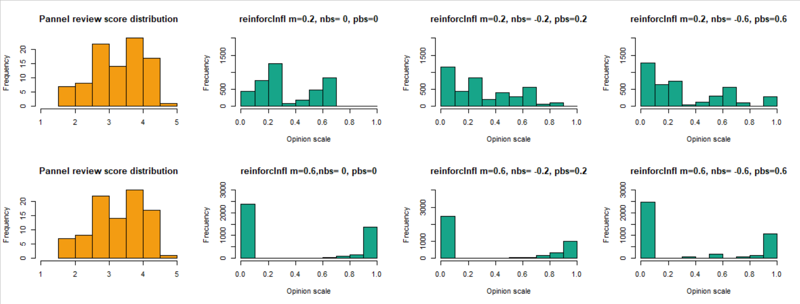
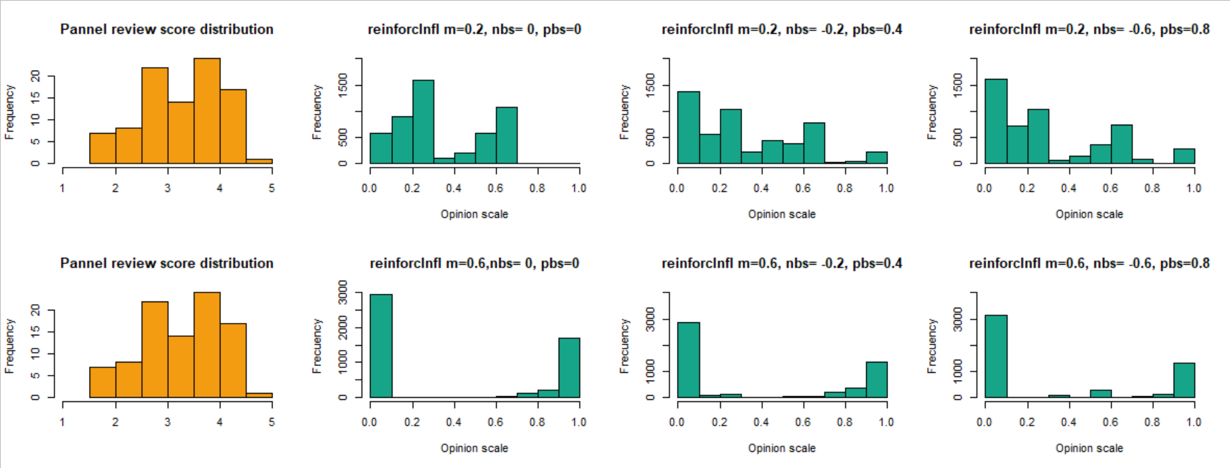
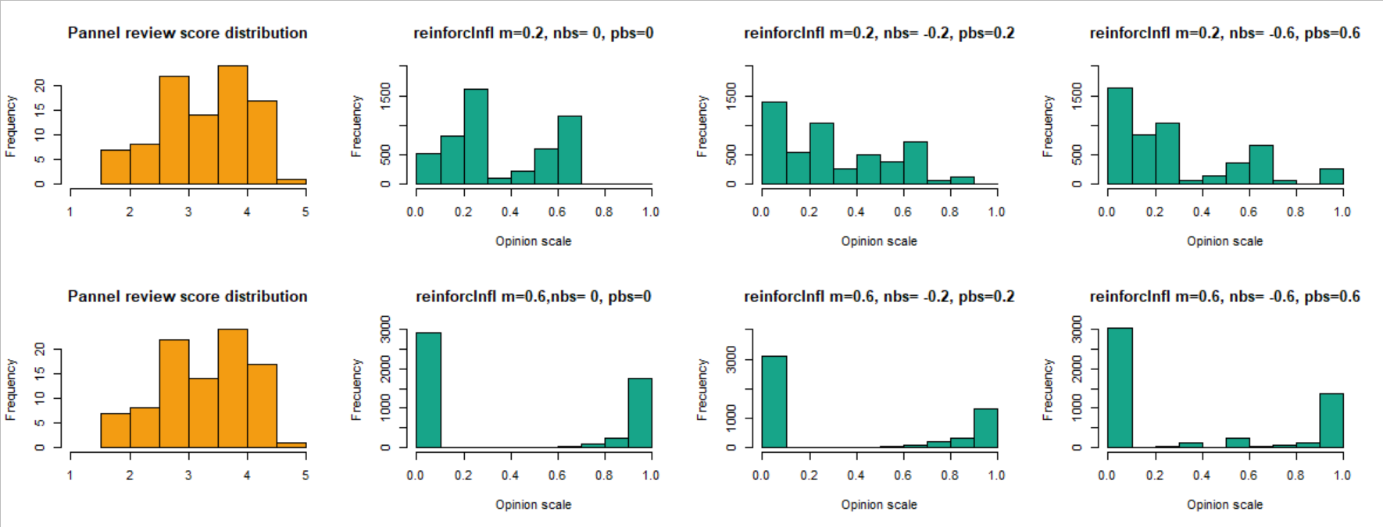
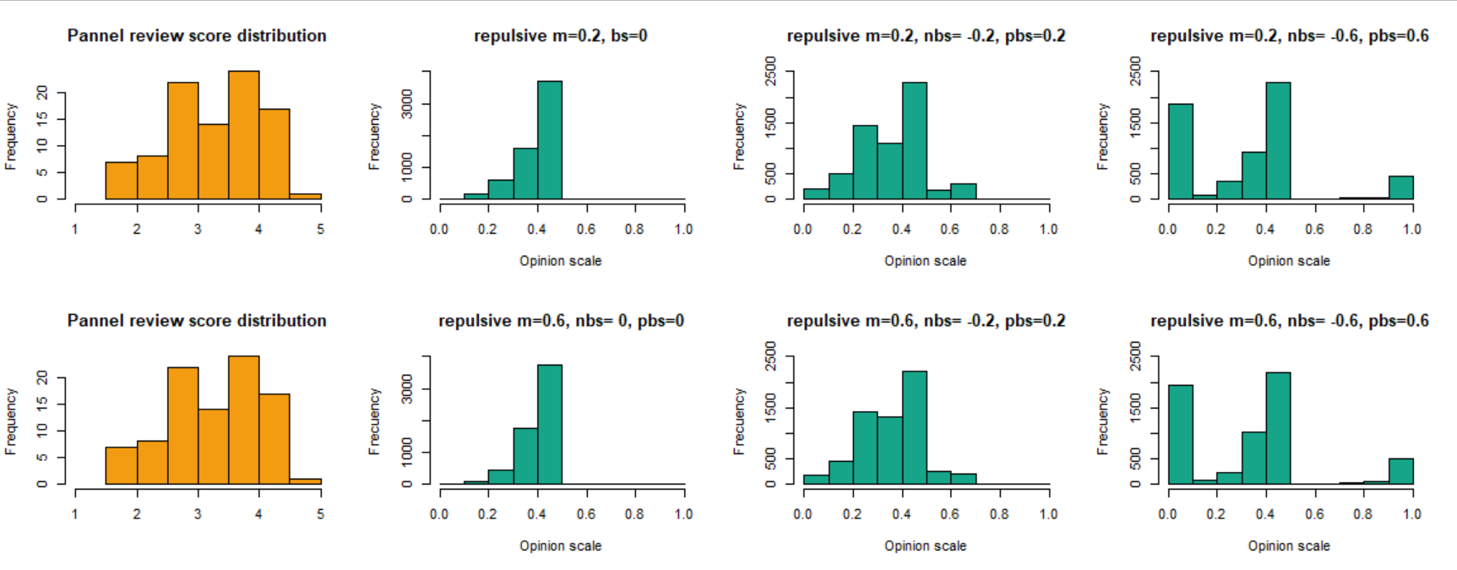
Conclusions
Reinforcing influence
Unbalanced influence
Assimilative influence
Repulsive influence
Repulsive influence
Reinforcing influence
Reinforcing influence
Repulsive influence
Repulsive influence
Panel composition: 5 reviewers
Balanced influence
Assimilative influence
Reinforcing influence

Slide 19
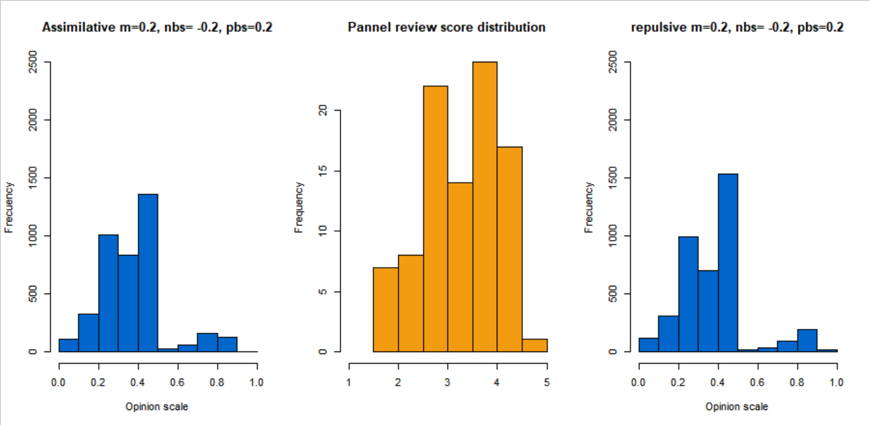
Conservatvism mechanism
Number of reviewers: 5; Balanced influence
Assimilative m=0.2, nbs=-0.2, pbs=+0.2
Stage 2 score distribution
Repulsive m=0.2, nbs=-0.2, pbs=+0.2

Slide 20
Conservatvism mechanism
Number of reviewers: 5; Balanced influence
Assimilative m=0.2, nbs=-0.2, pbs=+0.2
Stage 2 score distribution
Repulsive m=0.2, nbs=-0.2, pbs=+0.2

Slide 21
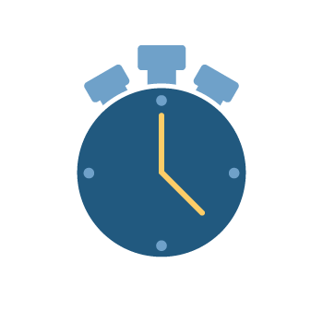
Future work
Implement time in the simulation
Hybrid models
Test new inputs with the current mechanisms
Implement the model by sections

Slide 22

Acknowledgment
My supervisors
The team
Junwen Luo
Thomas Feliciani
Kalpana Shankar
Pablo Lucas
Lai Ma
Clare Thornely
Gladson Scaria
Vineeth Das

Slide 23
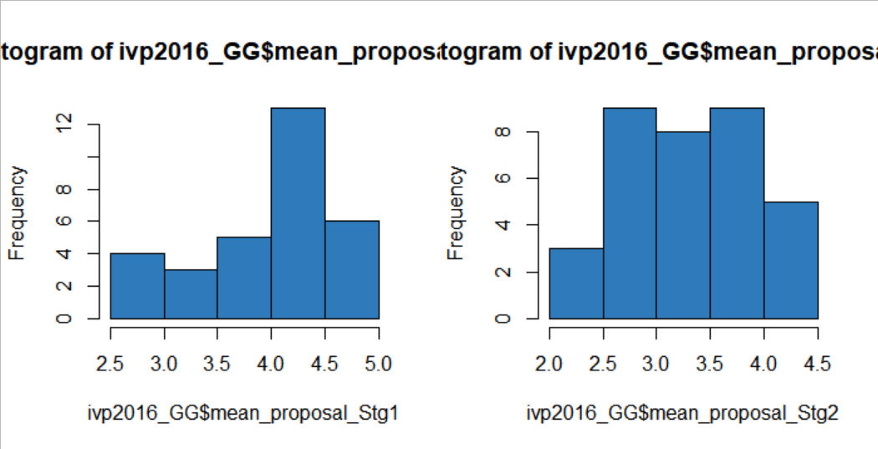
The future work
Ivp2016 by proposal
Stage 1
Stage 2
Change the input of the ABM. Grouping the results by proposal
BLACK-BOX

Slide 24
